Slide 1
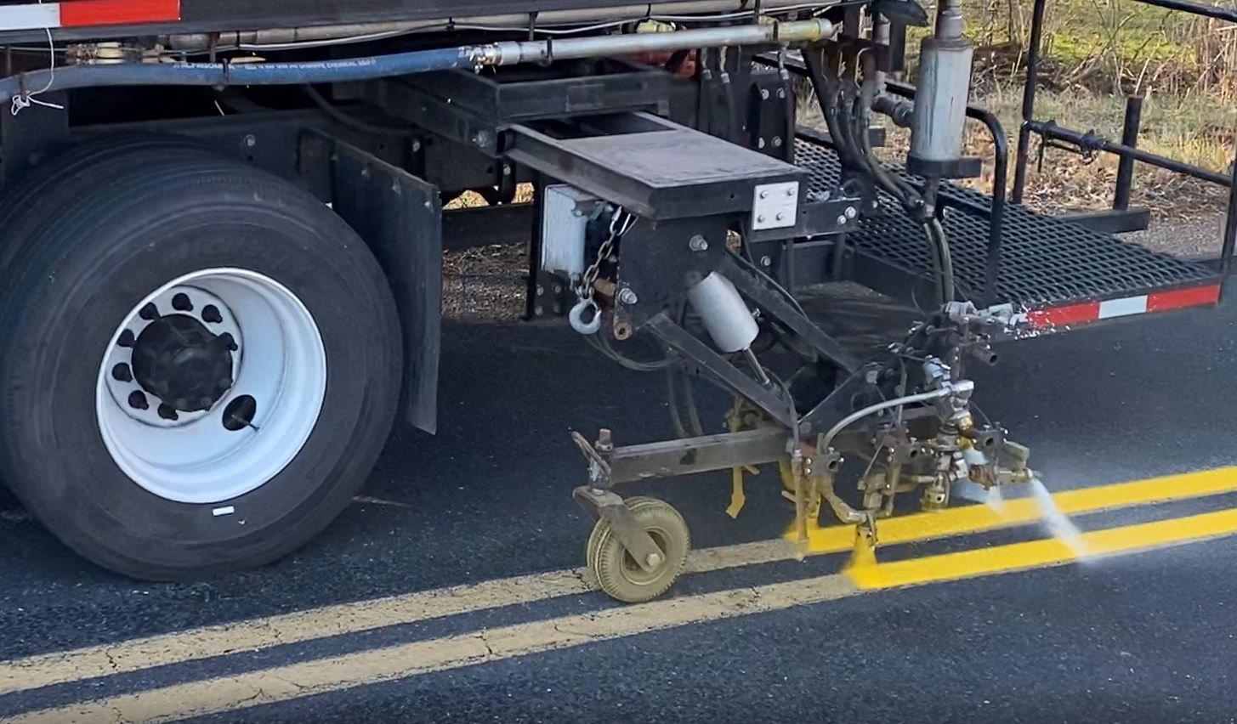
Automated Striping System Improvements
515 Hagey Rd.
Souderton, PA 18964
215-703-5510 office
215-703-5511 fax
www.limntech.com
Chris Davies
215-240-2223
chrisdavies@limntech.com

Slide 2
Automated Striping System Improvements Outline
Who is LimnTech?
What is Automated Layout?
How is it Improved?
How Does it Work?
How Is it Installed?
What is Automated Striping?
What Value does it bring?

Slide 3
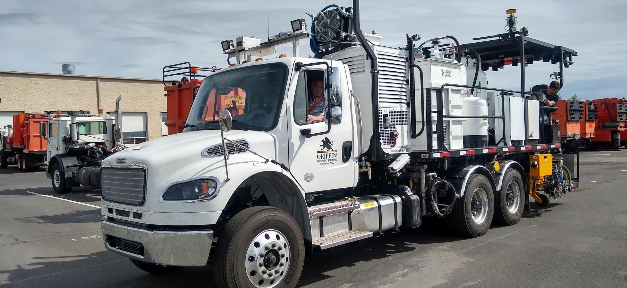
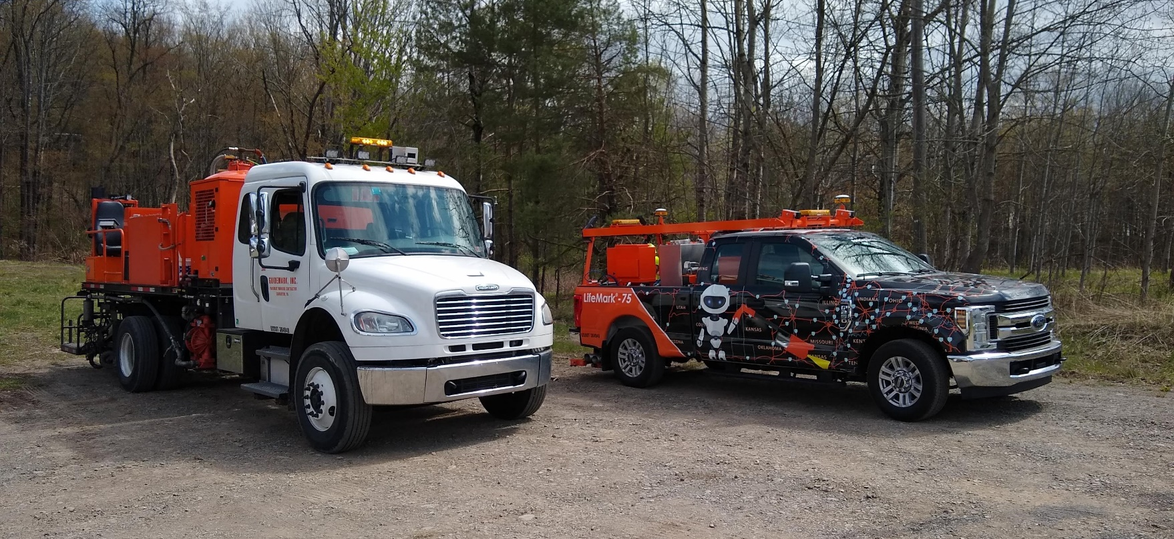
Introduction – Who is LimnTech
I am Chris Davies – 33 years at Potters, technical lead developing products.
Doug Dolinar owns LimnTech and Guidemark
LimnTech Scientific is a sister company to Guidemark, 40 year old striping company .
Over 900 years of striping experience for design engineers to draw on.
Notes:
LimnTech Scientific grew out of Doug Dolinars’s frustration with having employees being in dangerous situations while laying out road markings after re-paving.
Doug’s mechanical engineering background forms his basis for uniquely engineering solutions to make task safer. He brought in Bill Haller from Lehigh University to lead the electrical and software side of the robotic solutions to tasks. All of LimnTech Scientific engineers are from LeHigh.
This blend of engineers with actual road marking company operation experience leads us to be able to develop products that works for customers.
The LifeMark-75 was designed to record road marking location prior to re-paving and then be able to place layout marks from the truck all at traffic speed, in safety.
The keys I we get the operator out of the dangerous situation. We are also much more time productive.
The LifeMArk-75 is in operation across North America.

Slide 4
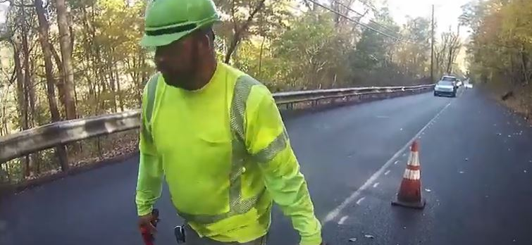
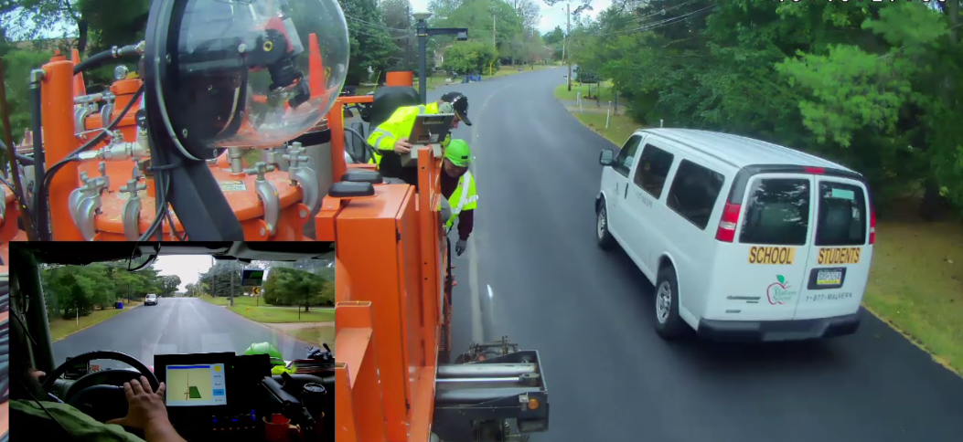
LimnTech Scientific history – who we are
Guidemark Inc.– a striping company since 1980
80 employees, 45 trucks, wide range of expertise
LimnTech Scientific layout truck LM-75 idea formed in 2010
LimnTech Scientific formed in 2012
Notes:
LimnTech Scientific grew out of Doug Dolinars’s frustration with having employees being in dangerous situations while laying out road markings after re-paving.
Doug’s mechanical engineering background forms his basis for uniquely engineering solutions to make task safer. He brought in Bill Haller from Lehigh University to lead the electrical and software side of the robotic solutions to tasks. All of LimnTech Scientific engineers are from LeHigh.
This blend of engineers with actual road marking company operation experience leads us to be able to develop products that works for customers.
The LifeMark-75 was designed to record road marking location prior to re-paving and then be able to place layout marks from the truck all at traffic speed, in safety.
The keys I we get the operator out of the dangerous situation. We are also much more time productive.
The LifeMArk-75 is in operation across North America.

Slide 5
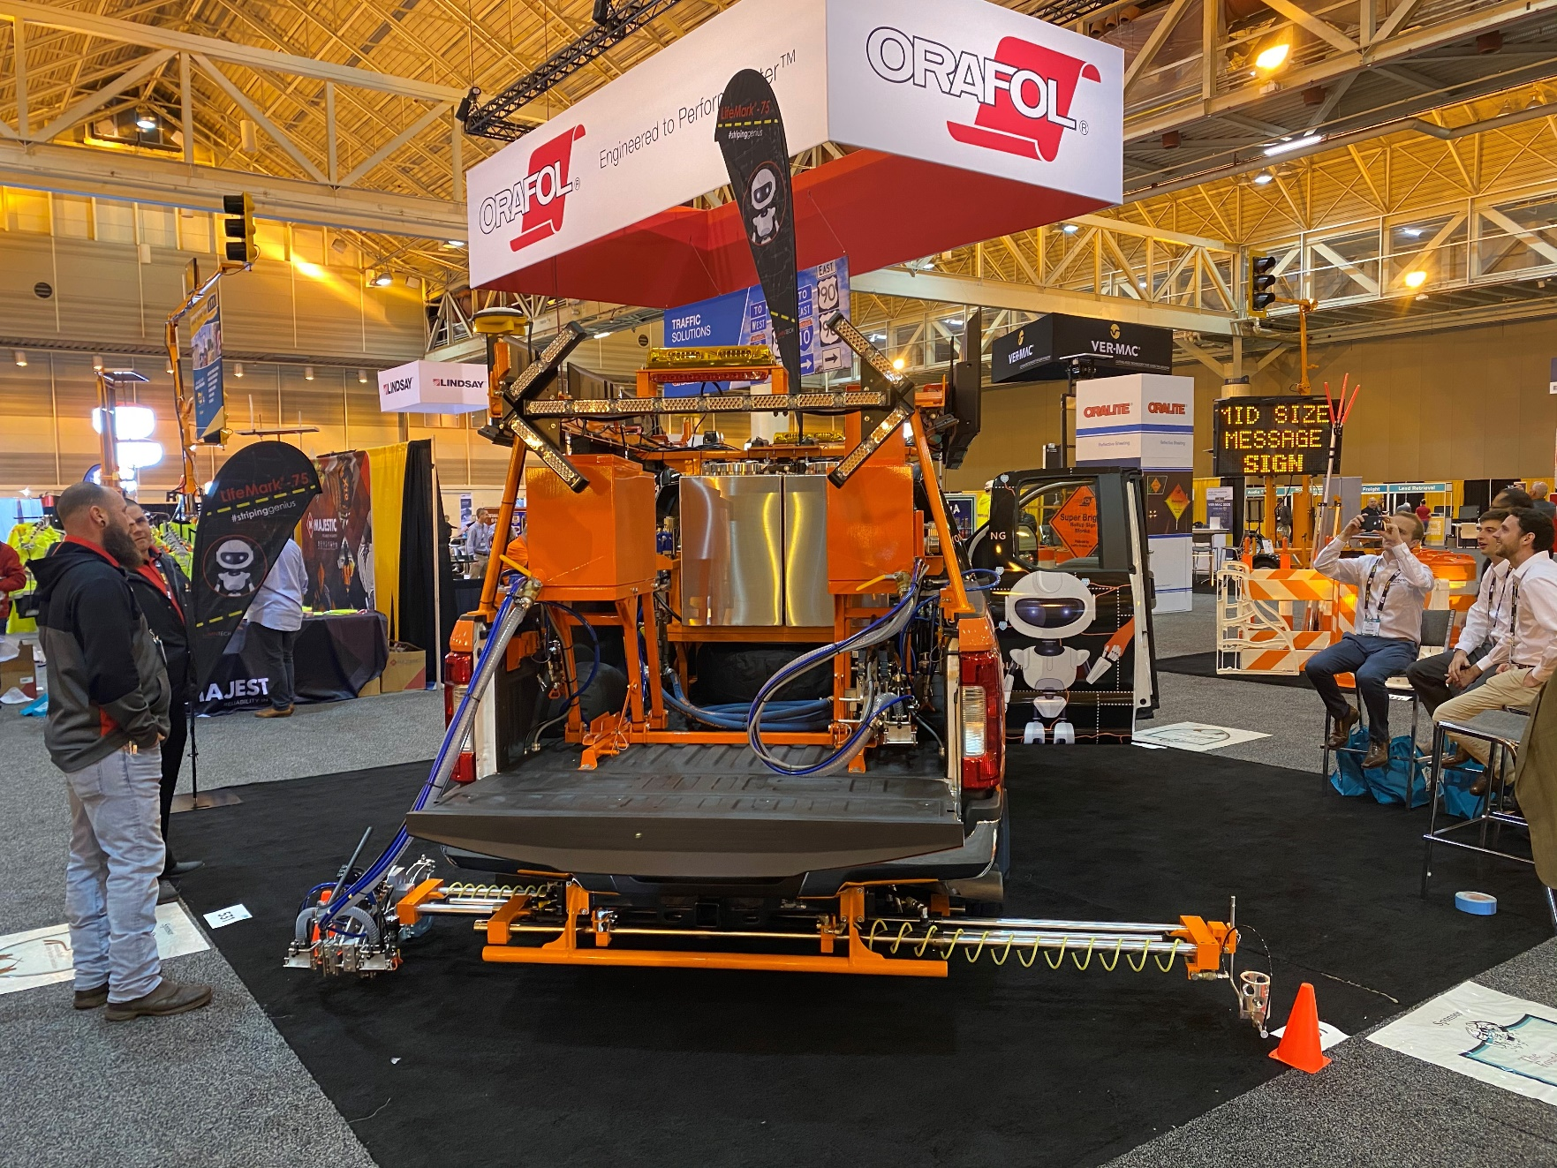
LimnTech Scientific LifeMark-75 Automated Layout System
First exhibit at ATSSA in 2013
First Sale of LM-75 in 2018 – on Paint truck
24 LM-75 systems in operation to date
9 LM-75 systems on paint trucks
Notes:
LimnTech Scientific grew out of Doug Dolinars’s frustration with having employees being in dangerous situations while laying out road markings after re-paving.
Doug’s mechanical engineering background forms his basis for uniquely engineering solutions to make task safer. He brought in Bill Haller from Lehigh University to lead the electrical and software side of the robotic solutions to tasks. All of LimnTech Scientific engineers are from LeHigh.
This blend of engineers with actual road marking company operation experience leads us to be able to develop products that works for customers.
The LifeMark-75 was designed to record road marking location prior to re-paving and then be able to place layout marks from the truck all at traffic speed, in safety.
The keys I we get the operator out of the dangerous situation. We are also much more time productive.
The LifeMArk-75 is in operation across North America.

Slide 6
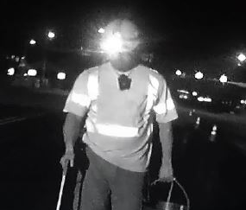
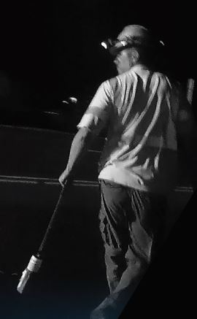
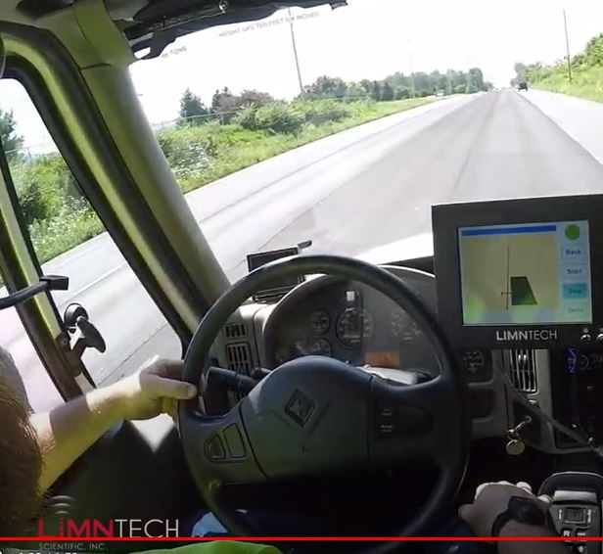
What is Automated Layout?
Conventional layout is performed after paving by hand.
Tape measures, chains and spray cans are used
Work is done in open traffic, day and night
It is very dangerous, time consuming work.
Notes:
LimnTech Scientific grew out of Doug Dolinars’s frustration with having employees being in dangerous situations while laying out road markings after re-paving.
Doug’s mechanical engineering background forms his basis for uniquely engineering solutions to make task safer. He brought in Bill Haller from Lehigh University to lead the electrical and software side of the robotic solutions to tasks. All of LimnTech Scientific engineers are from LeHigh.
This blend of engineers with actual road marking company operation experience leads us to be able to develop products that works for customers.
The LifeMark-75 was designed to record road marking location prior to re-paving and then be able to place layout marks from the truck all at traffic speed, in safety.
The keys I we get the operator out of the dangerous situation. We are also much more time productive.
The LifeMArk-75 is in operation across North America.

Slide 7
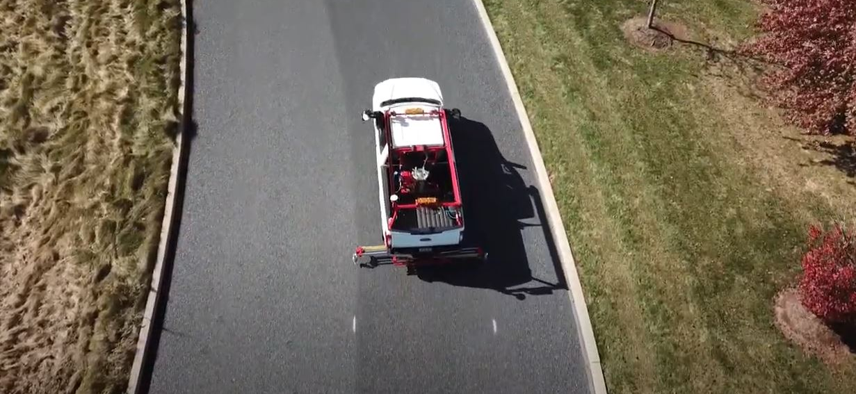
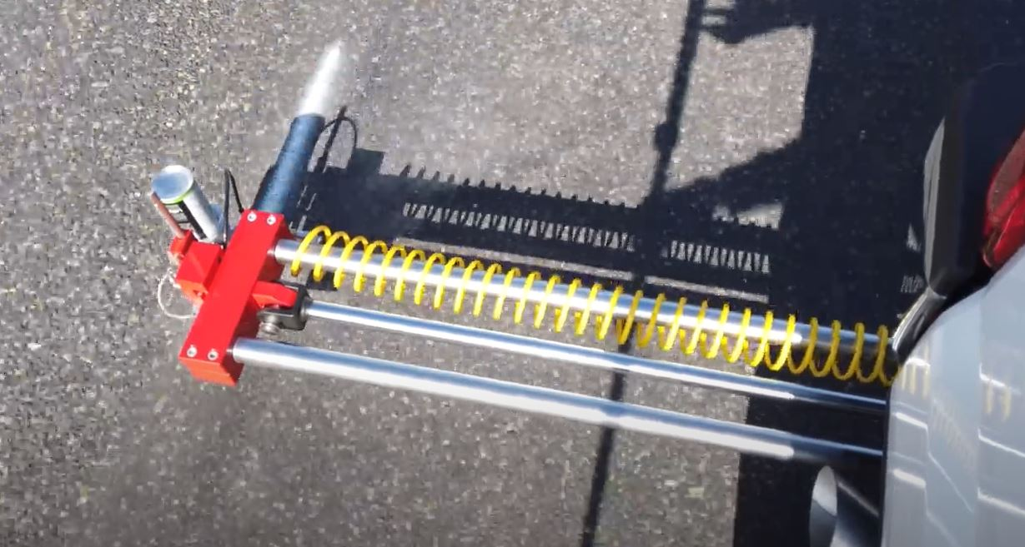
What is Automated Layout?
The LifeMark Automated Layout System is used to record the marking locations from the safety of a moving truck, before the road is re-paved.
GPS/RTK Technology is used to maintain high accuracy
Data is safely stored in the cloud
LifeMark-75 uses manual pointers to record.
Notes:
LimnTech Scientific grew out of Doug Dolinars’s frustration with having employees being in dangerous situations while laying out road markings after re-paving.
Doug’s mechanical engineering background forms his basis for uniquely engineering solutions to make task safer. He brought in Bill Haller from Lehigh University to lead the electrical and software side of the robotic solutions to tasks. All of LimnTech Scientific engineers are from LeHigh.
This blend of engineers with actual road marking company operation experience leads us to be able to develop products that works for customers.
The LifeMark-75 was designed to record road marking location prior to re-paving and then be able to place layout marks from the truck all at traffic speed, in safety.
The keys I we get the operator out of the dangerous situation. We are also much more time productive.
The LifeMArk-75 is in operation across North America.

Slide 8
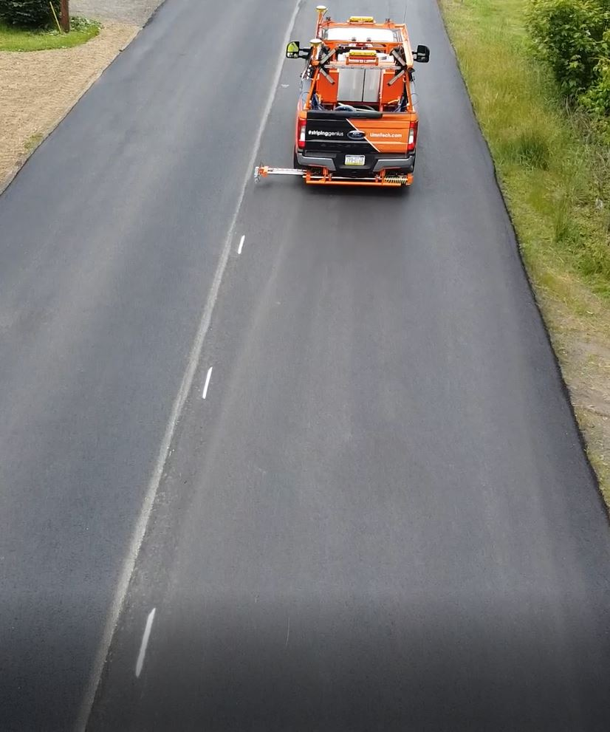
What is Automated Layout?
The driver steers the pointer to be on the line.
One line is recorded at a time.
Layout is performed after paving using LifeMark Automated Layout uses GPS and RTK to align the paint carriage to paint layout marks.
Control boxes are used to place the markings at the correct length and spacing.
Notes:
LimnTech Scientific grew out of Doug Dolinars’s frustration with having employees being in dangerous situations while laying out road markings after re-paving.
Doug’s mechanical engineering background forms his basis for uniquely engineering solutions to make task safer. He brought in Bill Haller from Lehigh University to lead the electrical and software side of the robotic solutions to tasks. All of LimnTech Scientific engineers are from LeHigh.
This blend of engineers with actual road marking company operation experience leads us to be able to develop products that works for customers.
The LifeMark-75 was designed to record road marking location prior to re-paving and then be able to place layout marks from the truck all at traffic speed, in safety.
The keys I we get the operator out of the dangerous situation. We are also much more time productive.
The LifeMArk-75 is in operation across North America.

Slide 10
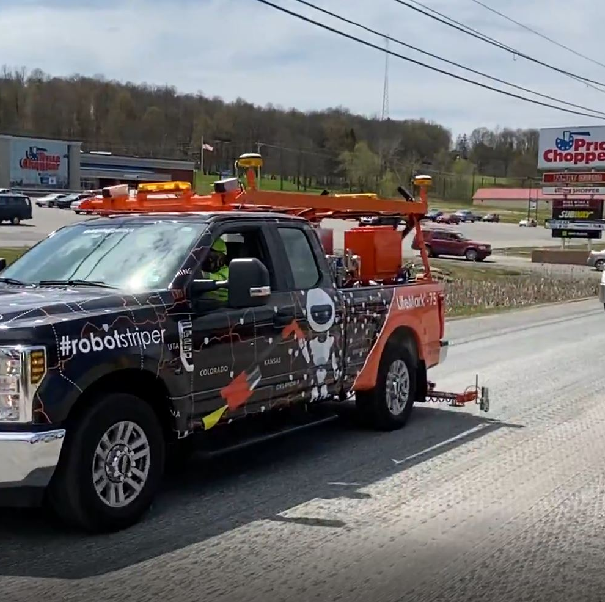
What is Automated Layout?
The Layout Team can layout the road after paving from the safety of the truck, two lines at a time, at up to 10 mph
The LifeMark system uses GPS, RTK correction and smart hydraulics to place the marks in the previously recorded spots.
LifeMark Automated Layout systems are available for pickup trucks or full size stripers

Slide 11
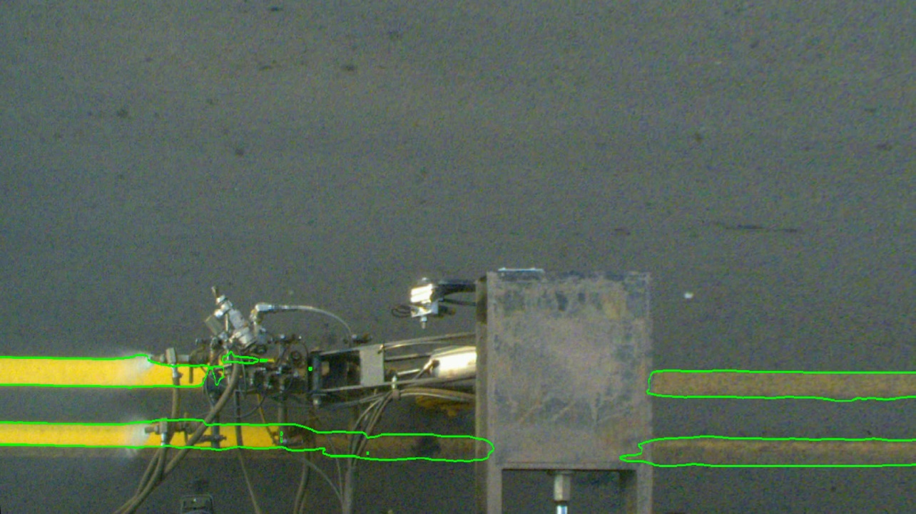
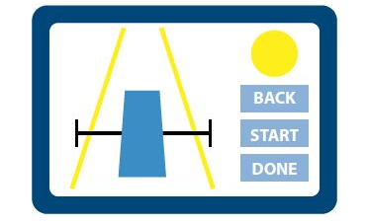
New Technology!!
LifeMark-100 Automated Marking Location Recording uses cameras and computers to record both sides automatically
GPS technology uses RTK correction factors to improve accuracy to within 2 inches.
Recording Driver needs to simply stay in his lane
Notes:
LimnTech Scientific grew out of Doug Dolinars’s frustration with having employees being in dangerous situations while laying out road markings after re-paving.
Doug’s mechanical engineering background forms his basis for uniquely engineering solutions to make task safer. He brought in Bill Haller from Lehigh University to lead the electrical and software side of the robotic solutions to tasks. All of LimnTech Scientific engineers are from LeHigh.
This blend of engineers with actual road marking company operation experience leads us to be able to develop products that works for customers.
The LifeMark-75 was designed to record road marking location prior to re-paving and then be able to place layout marks from the truck all at traffic speed, in safety.
The keys I we get the operator out of the dangerous situation. We are also much more time productive.
The LifeMArk-75 is in operation across North America.

Slide 13
This view shows the representation of the edges detected of the old line

Slide 14
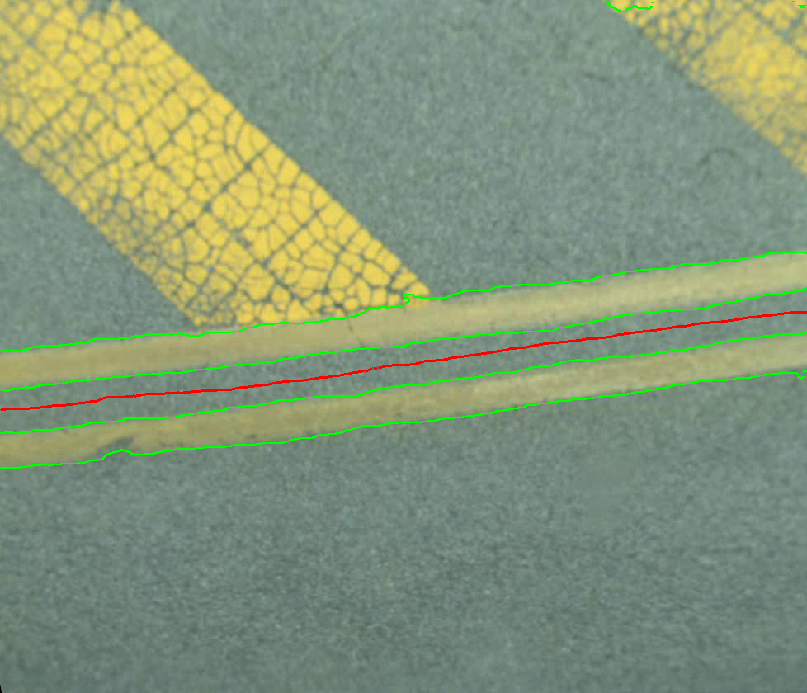
This view shows the spline generated by the software of the lines on the road

Slide 15
Improvements to the LifeMark Layout System
LifeMark-100 uses cameras to record marking location.
We can now record from both sides of the truck in one pass, at highway speed
Driver movements during recording will not affect recording quality
Camera view is wide, 7 feet by 21 feet on each side
20 to 30 images taken per second
High Resolution Cameras

Slide 16
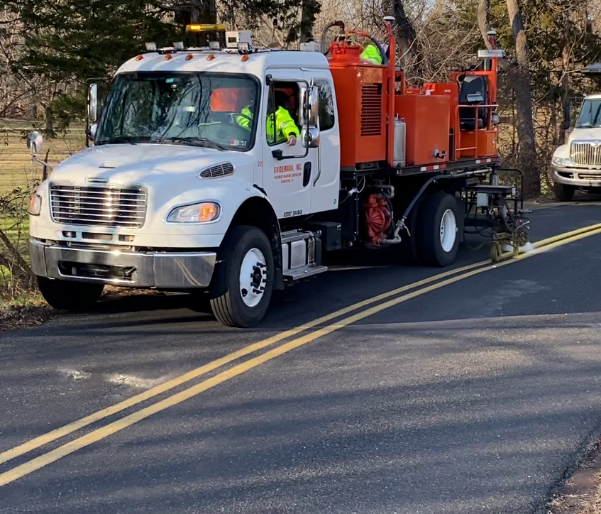
How Does it Work?
Simply drive the lane, and record both sides from the safety of the vehicle.
Improvements in computer technology have brought supercomputer abilities to the level of affordability for the road striping industry.
Stripe width and length is measured.
Passing patterns are recognized
Worn lines are recognized
Notes:
LimnTech Scientific grew out of Doug Dolinars’s frustration with having employees being in dangerous situations while laying out road markings after re-paving.
Doug’s mechanical engineering background forms his basis for uniquely engineering solutions to make task safer. He brought in Bill Haller from Lehigh University to lead the electrical and software side of the robotic solutions to tasks. All of LimnTech Scientific engineers are from LeHigh.
This blend of engineers with actual road marking company operation experience leads us to be able to develop products that works for customers.
The LifeMark-75 was designed to record road marking location prior to re-paving and then be able to place layout marks from the truck all at traffic speed, in safety.
The keys I we get the operator out of the dangerous situation. We are also much more time productive.
The LifeMArk-75 is in operation across North America.

Slide 17
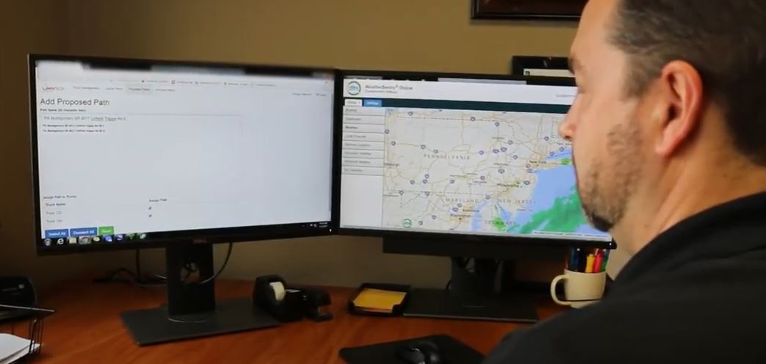
How Does it Work?
The key is the software, optimized to be able to maintain high accuracy using GPS correction.
The striping truck also needs to know where the paint gun is at all times to accurately layout or re-stripe.
Layout after recording needs a LifeMark system on the truck
Notes:
LimnTech Scientific grew out of Doug Dolinars’s frustration with having employees being in dangerous situations while laying out road markings after re-paving.
Doug’s mechanical engineering background forms his basis for uniquely engineering solutions to make task safer. He brought in Bill Haller from Lehigh University to lead the electrical and software side of the robotic solutions to tasks. All of LimnTech Scientific engineers are from LeHigh.
This blend of engineers with actual road marking company operation experience leads us to be able to develop products that works for customers.
The LifeMark-75 was designed to record road marking location prior to re-paving and then be able to place layout marks from the truck all at traffic speed, in safety.
The keys I we get the operator out of the dangerous situation. We are also much more time productive.
The LifeMArk-75 is in operation across North America.

Slide 18
How Does it Work?
Smart hydraulic valves and cylinders are installed in your striping truck so that the computer can tell the paint carriage when and where to move.
Notes:
LimnTech Scientific grew out of Doug Dolinars’s frustration with having employees being in dangerous situations while laying out road markings after re-paving.
Doug’s mechanical engineering background forms his basis for uniquely engineering solutions to make task safer. He brought in Bill Haller from Lehigh University to lead the electrical and software side of the robotic solutions to tasks. All of LimnTech Scientific engineers are from LeHigh.
This blend of engineers with actual road marking company operation experience leads us to be able to develop products that works for customers.
The LifeMark-75 was designed to record road marking location prior to re-paving and then be able to place layout marks from the truck all at traffic speed, in safety.
The keys I we get the operator out of the dangerous situation. We are also much more time productive.
The LifeMArk-75 is in operation across North America.

Slide 19
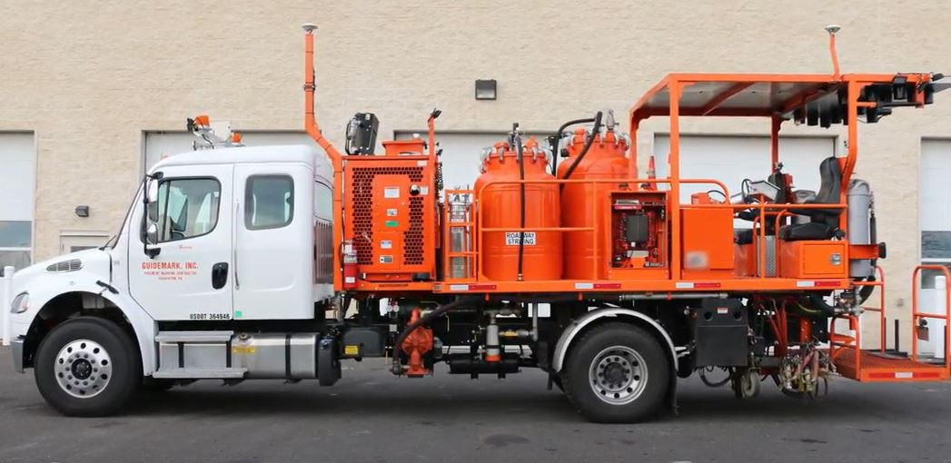
How Is it Installed?
The truck is surveyed in detail so that customized parts can be designed and fabricated.
Once the parts are in stock, the assembly takes less than a week.
Customers can combine installation with winter cleaning and refurbishment.
Notes:
LimnTech Scientific grew out of Doug Dolinars’s frustration with having employees being in dangerous situations while laying out road markings after re-paving.
Doug’s mechanical engineering background forms his basis for uniquely engineering solutions to make task safer. He brought in Bill Haller from Lehigh University to lead the electrical and software side of the robotic solutions to tasks. All of LimnTech Scientific engineers are from LeHigh.
This blend of engineers with actual road marking company operation experience leads us to be able to develop products that works for customers.
The LifeMark-75 was designed to record road marking location prior to re-paving and then be able to place layout marks from the truck all at traffic speed, in safety.
The keys I we get the operator out of the dangerous situation. We are also much more time productive.
The LifeMArk-75 is in operation across North America.

Slide 20
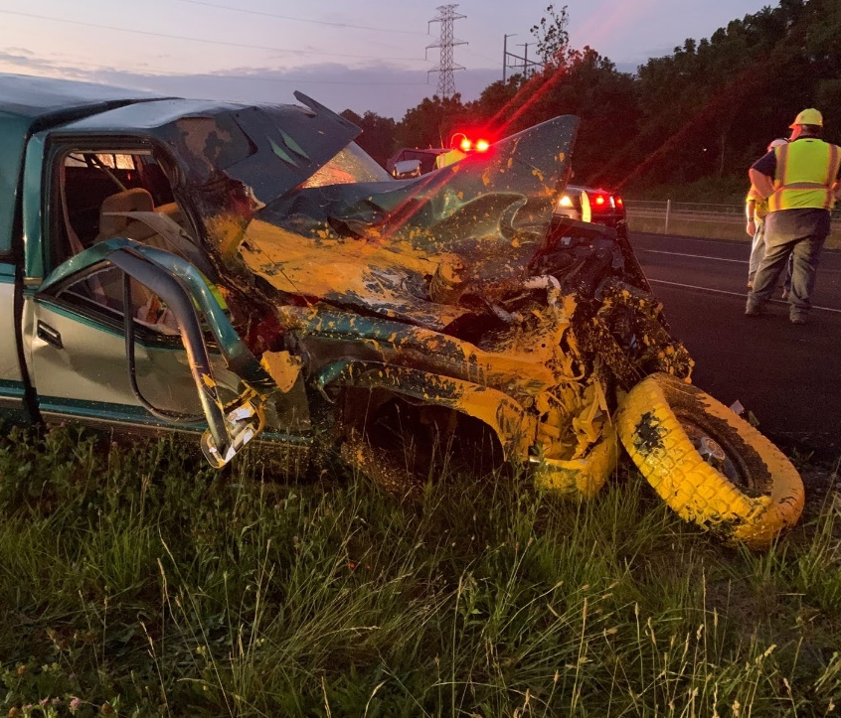
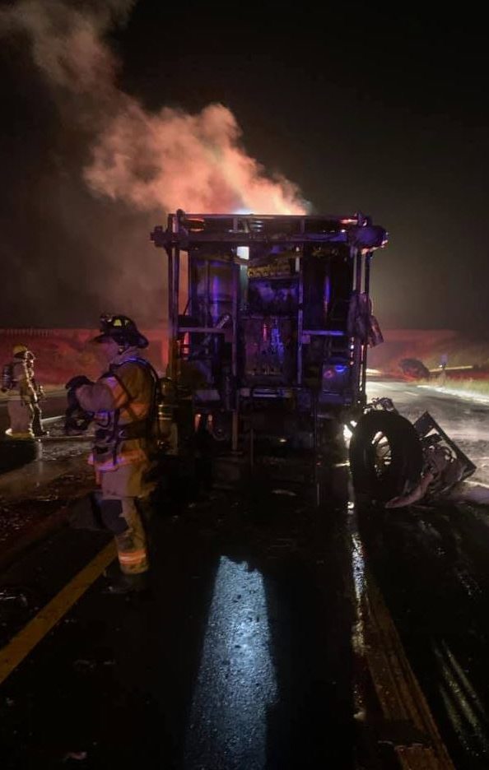
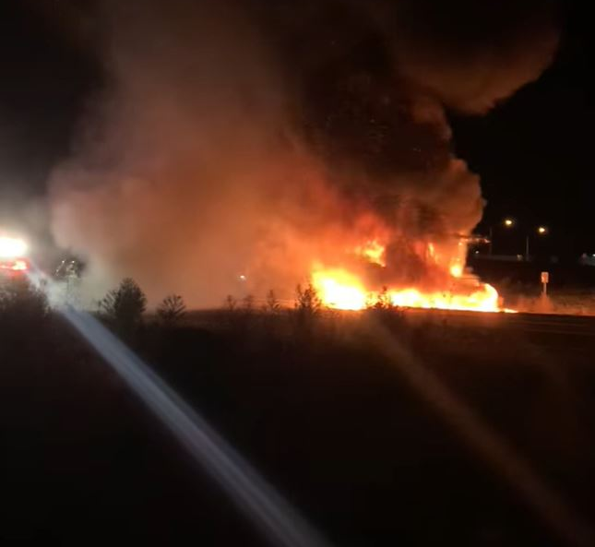
What Value does it bring?
The primary value this brings is safety.
The removal of layout workers from the roadway eliminates the possibility of injury during a common accident - a collision of an inattentive driver during striping operation, resulting in death of a worker performing layout.
This type of accident is on the rise.
Notes:
LimnTech Scientific grew out of Doug Dolinars’s frustration with having employees being in dangerous situations while laying out road markings after re-paving.
Doug’s mechanical engineering background forms his basis for uniquely engineering solutions to make task safer. He brought in Bill Haller from Lehigh University to lead the electrical and software side of the robotic solutions to tasks. All of LimnTech Scientific engineers are from LeHigh.
This blend of engineers with actual road marking company operation experience leads us to be able to develop products that works for customers.
The LifeMark-75 was designed to record road marking location prior to re-paving and then be able to place layout marks from the truck all at traffic speed, in safety.
The keys I we get the operator out of the dangerous situation. We are also much more time productive.
The LifeMArk-75 is in operation across North America.

Slide 21
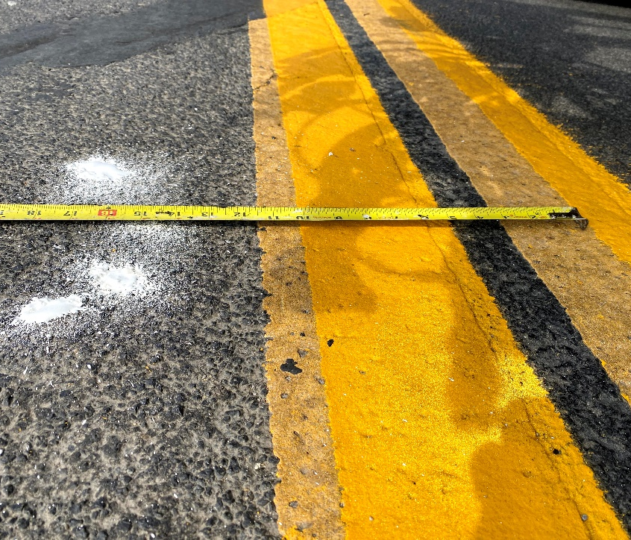
What Value does it bring?
Secondary value is that the system is accurate and consistent.
Automating repetitive, dangerous jobs is a key to improving quality of marking installation.
Our accuracy is within two inches.
Notes:
LimnTech Scientific grew out of Doug Dolinars’s frustration with having employees being in dangerous situations while laying out road markings after re-paving.
Doug’s mechanical engineering background forms his basis for uniquely engineering solutions to make task safer. He brought in Bill Haller from Lehigh University to lead the electrical and software side of the robotic solutions to tasks. All of LimnTech Scientific engineers are from LeHigh.
This blend of engineers with actual road marking company operation experience leads us to be able to develop products that works for customers.
The LifeMark-75 was designed to record road marking location prior to re-paving and then be able to place layout marks from the truck all at traffic speed, in safety.
The keys I we get the operator out of the dangerous situation. We are also much more time productive.
The LifeMArk-75 is in operation across North America.

Slide 22
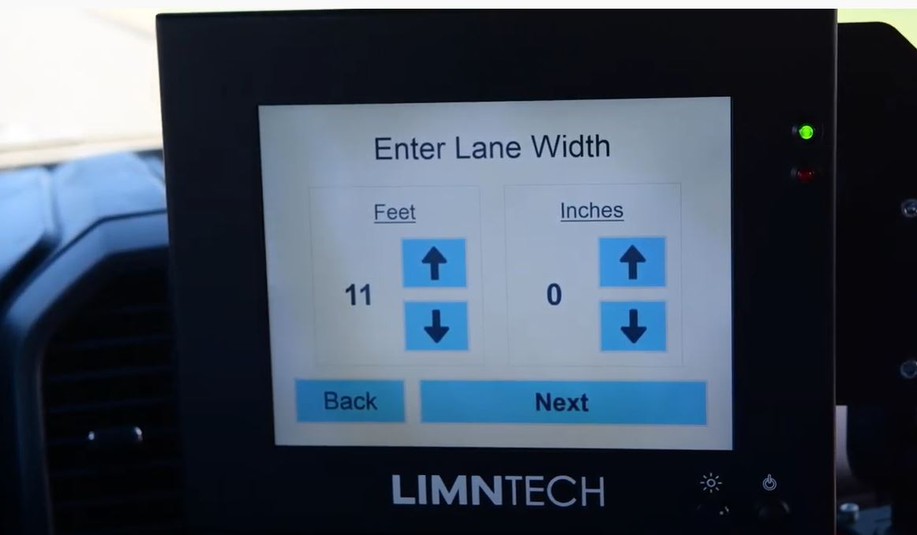
What Value does it bring?
Thirdly, operators that were used for layout operation are now available for other tasks.
Layout can be performed with one operator from the safety of the truck
Notes:
LimnTech Scientific grew out of Doug Dolinars’s frustration with having employees being in dangerous situations while laying out road markings after re-paving.
Doug’s mechanical engineering background forms his basis for uniquely engineering solutions to make task safer. He brought in Bill Haller from Lehigh University to lead the electrical and software side of the robotic solutions to tasks. All of LimnTech Scientific engineers are from LeHigh.
This blend of engineers with actual road marking company operation experience leads us to be able to develop products that works for customers.
The LifeMark-75 was designed to record road marking location prior to re-paving and then be able to place layout marks from the truck all at traffic speed, in safety.
The keys I we get the operator out of the dangerous situation. We are also much more time productive.
The LifeMArk-75 is in operation across North America.

Slide 23
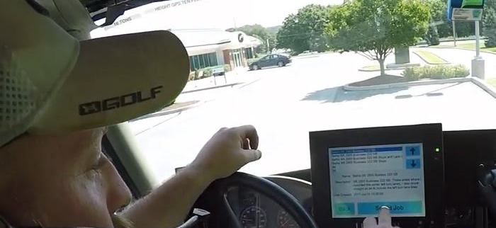
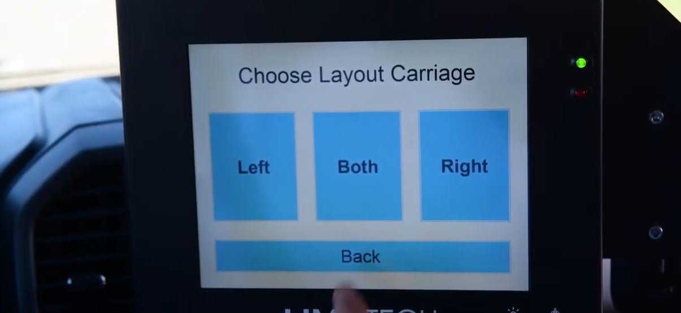
What Value does it bring?
Fourth – Our systems are designed to be intuitive and simple to operate.
Many operators are capable of striping with telephone training.
Our system can always switch back to manual operation at any time, to use the truck as needed.
Notes:
LimnTech Scientific grew out of Doug Dolinars’s frustration with having employees being in dangerous situations while laying out road markings after re-paving.
Doug’s mechanical engineering background forms his basis for uniquely engineering solutions to make task safer. He brought in Bill Haller from Lehigh University to lead the electrical and software side of the robotic solutions to tasks. All of LimnTech Scientific engineers are from LeHigh.
This blend of engineers with actual road marking company operation experience leads us to be able to develop products that works for customers.
The LifeMark-75 was designed to record road marking location prior to re-paving and then be able to place layout marks from the truck all at traffic speed, in safety.
The keys I we get the operator out of the dangerous situation. We are also much more time productive.
The LifeMArk-75 is in operation across North America.

Slide 24
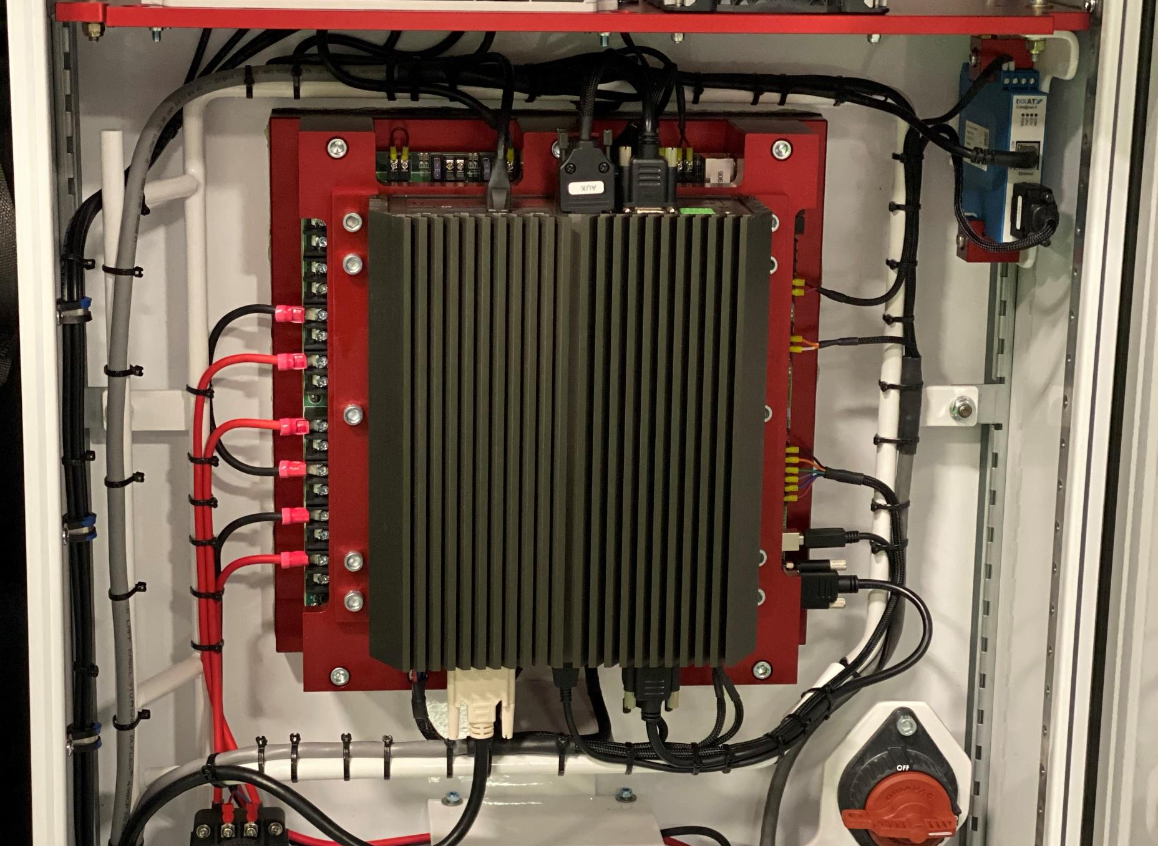
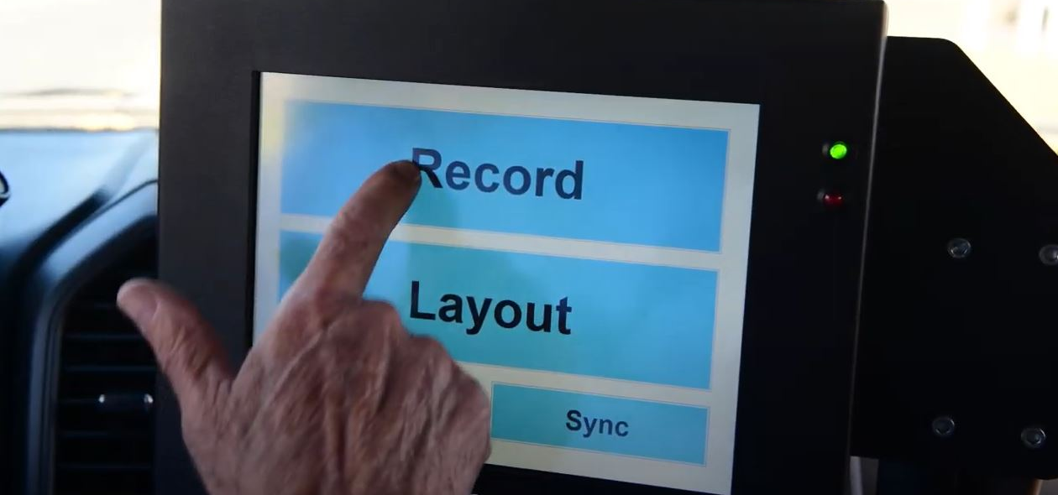
LIFEMARK AUTOMATED STRIPING SYSTEM COMMON COMPONENTS
Touchscreen Control Box in Driver’s Cab
Smart Cylinders Mounted into Carriages
Valve Body to Control Smart Cylinders
Computer Control Cabinet on Deck
Includes full installation of both sides operational, training and one year warranty and service
Notes:
There are 6 basic component sets involved.
Touchscreen monitor display in the front cab
Smart cylinders in each paint carriage
Valve body system to move the Smart Cylinders.
Waterproof Computer Control Cabinet on truck deck, with all wires run to it
Paint Gun control box to turn guns on and off
Cameras mounted on each side of the truck to see the worn and newly applied markings

Slide 25
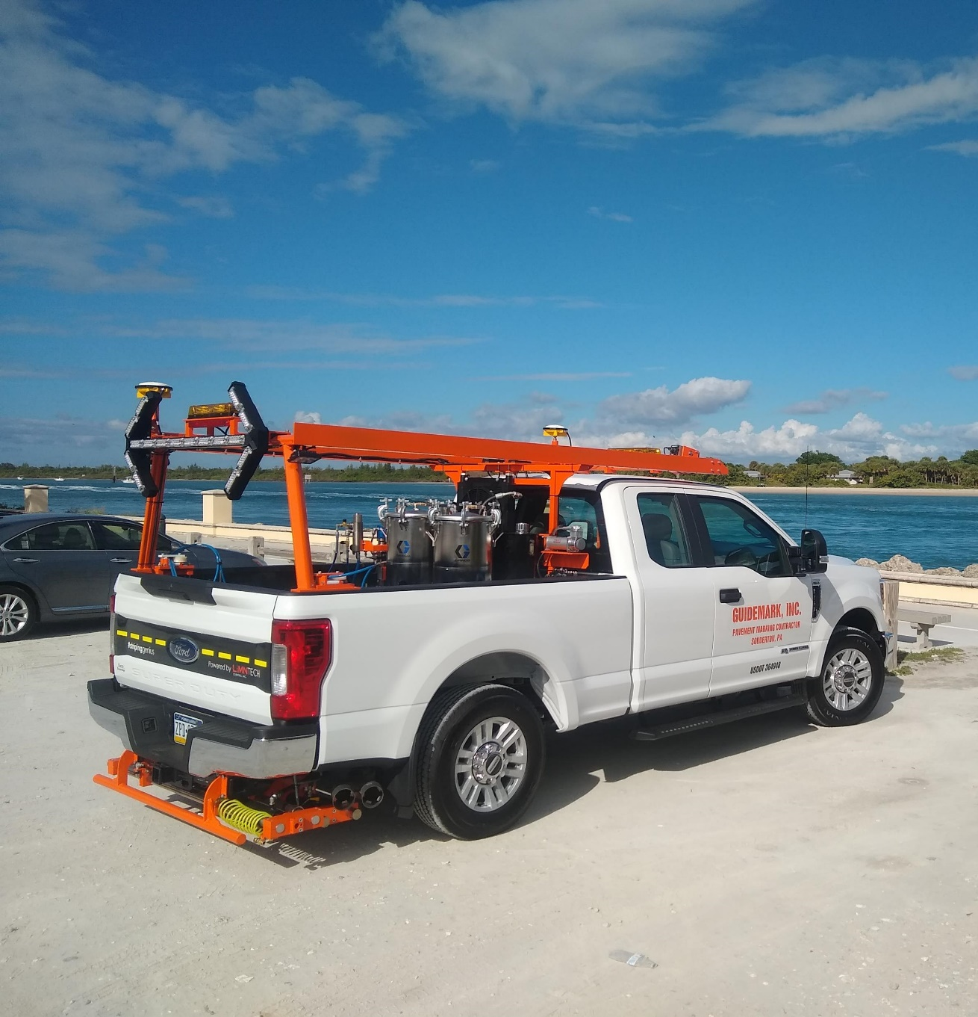
LIFEMARK 100 AUTOMATED LAYOUT SYSTEM COMPONENTS
Touchscreen Control Box in Driver’s Cab
Smart Cylinders Mounted into Carriages
Valve Body to Control Smart Cylinders
Computer Control Cabinet on Deck
Gun Control Box
GPS Antennas, INS and RTK correction service equipment
Overview Cameras, Carriage Cameras and Towers
System Price $136,000 both carriages
Record only system Price $85,000

Slide 26
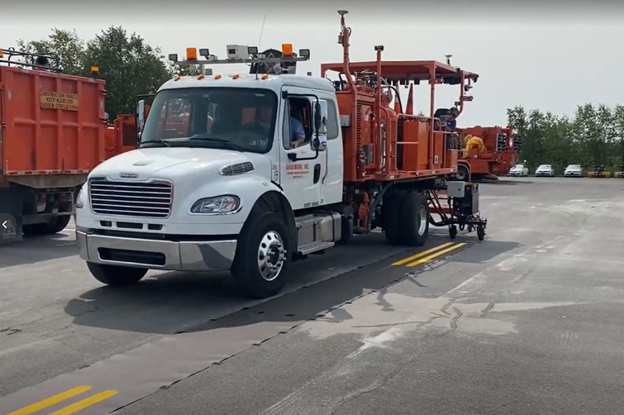
LIFEMARK 100 AUTOMATED LAYOUT SYSTEM COMPONENTS
Touchscreen Control Box in Driver’s Cab
Smart Cylinders Mounted into Carriages
Valve Body to Control Smart Cylinders
Computer Control Cabinet on Deck
Gun Control Box
GPS Antennas, INS and RTK correction service equipment
Overview Cameras, Carriage Cameras and Towers
System Price $136,000 both carriages
Record only system Price $85,000

Slide 27
LIFEMARK 300 AUTOMATED RESTRIPE SYSTEM COMPONENTS
Touchscreen Control Box in Driver’s Cab
Smart Cylinders Mounted into Carriages
Valve Body to Control Smart Cylinders
Computer Control Cabinet on Deck
Gun Control Box
Overview Cameras, Carriage Cameras and Towers
System Price $136,000 for both sides

Slide 28
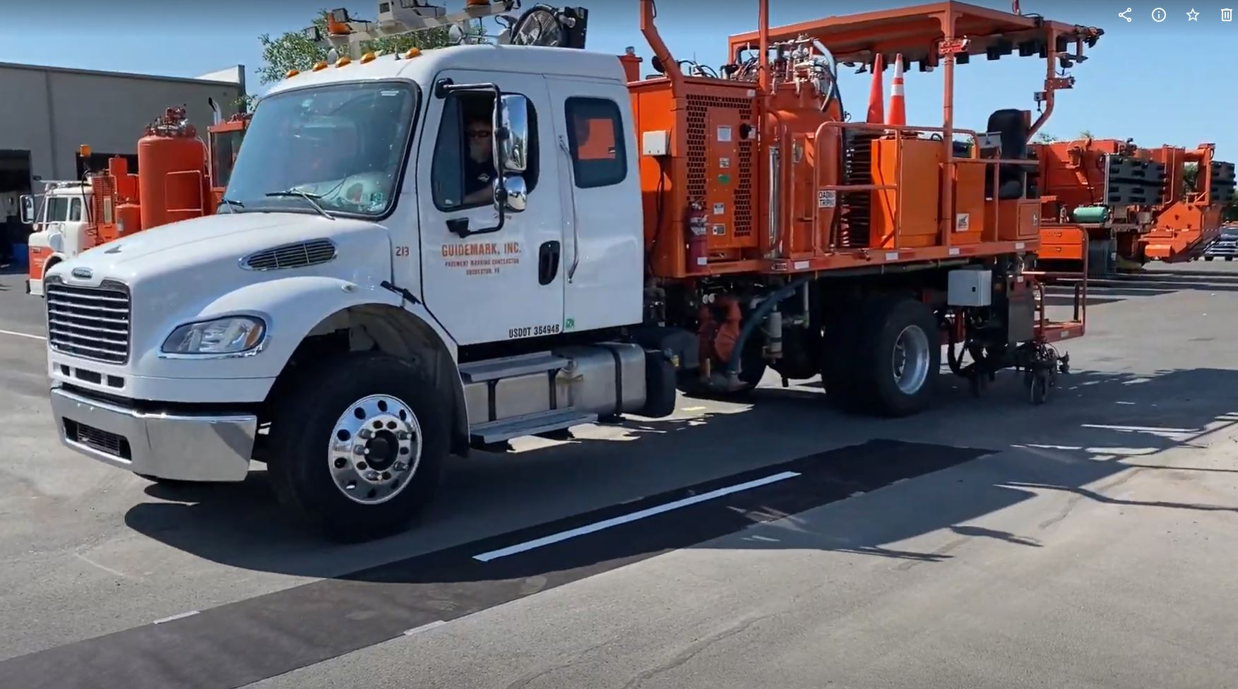
LIFEMARK 400 AUTOMATED RESTRIPE, LAYOUT AND RECORD SYSTEM COMPONENTS
Touchscreen Control Box in Driver’s Cab
Smart Cylinders Mounted into Carriages
Valve Body to Control Smart Cylinders
Computer Control Cabinet on Deck
Gun Control Box
Overview Cameras, Carriage Cameras and Towers
GPS Antennas, INS and RTK correction service equipment
System Price $162,000 both sides

